Slide 1



DIFFERENTIAL GENE EXPRESSION ANALYSIS
SARTHAK RAY

Slide 2
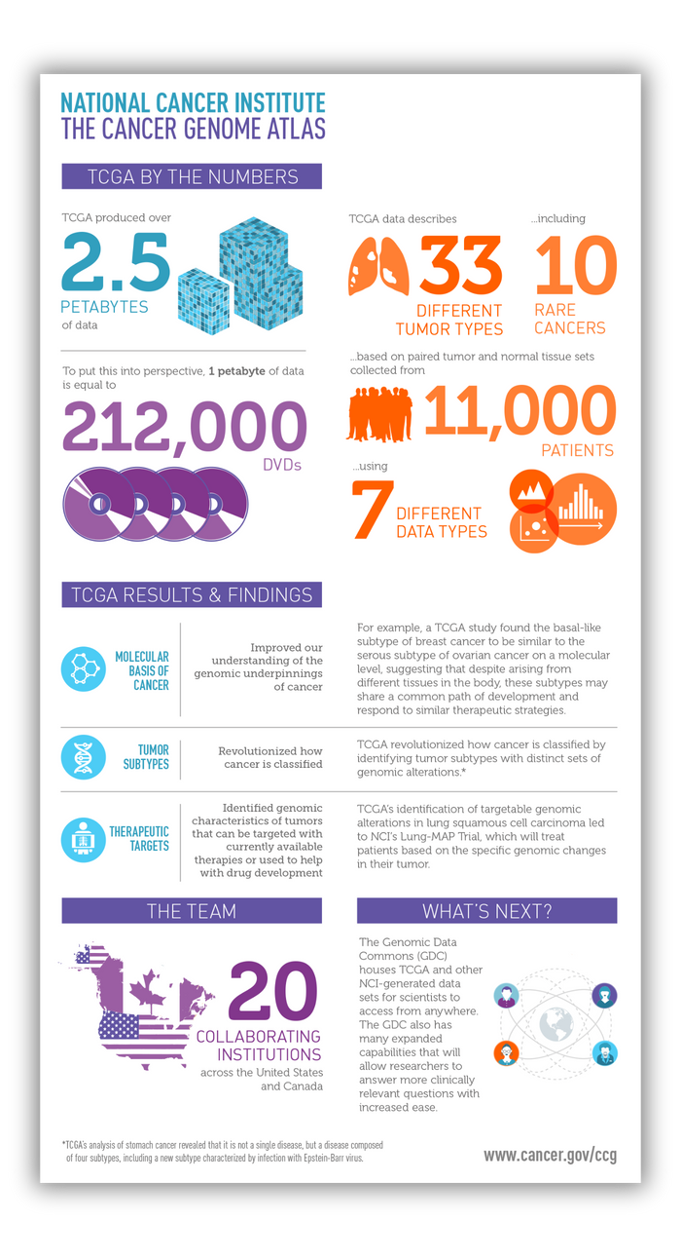



TCGA
THE CANCER GENOME ATLAS
The Cancer Genome Atlas (TCGA) is a project to catalogue the genetic mutations responsible for cancer using genome sequencing and bioinformatics.
This joint effort between NCI and the National Human Genome Research Institute began in 2006, bringing together researchers from diverse disciplines and multiple institutions.

Slide 3
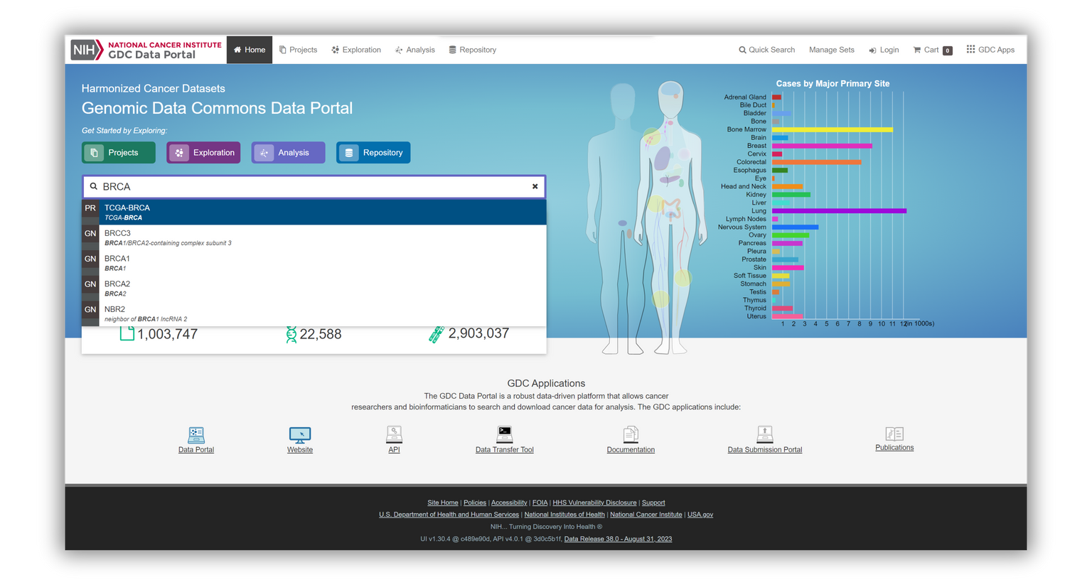


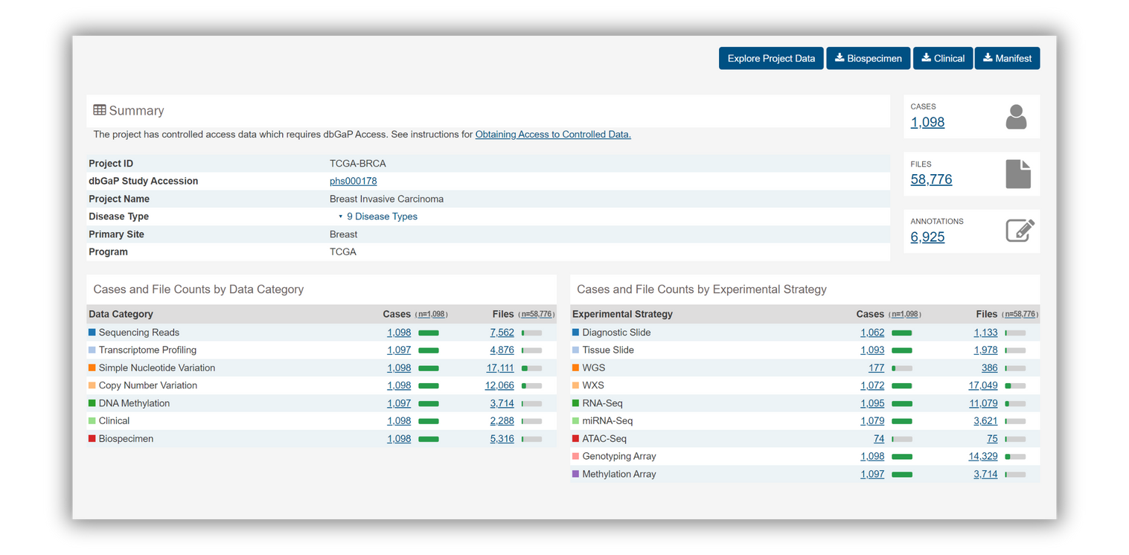
GDC DATA PORTAL
Visit https://portal.gdc.cancer.gov/
Look for TCGA-BRCA in the search bar.
You land here in the summary page which describes the project.
In our case we’ll study Breast Invasive Carcinoma.
Go to “Explore Project Data”.

Slide 4
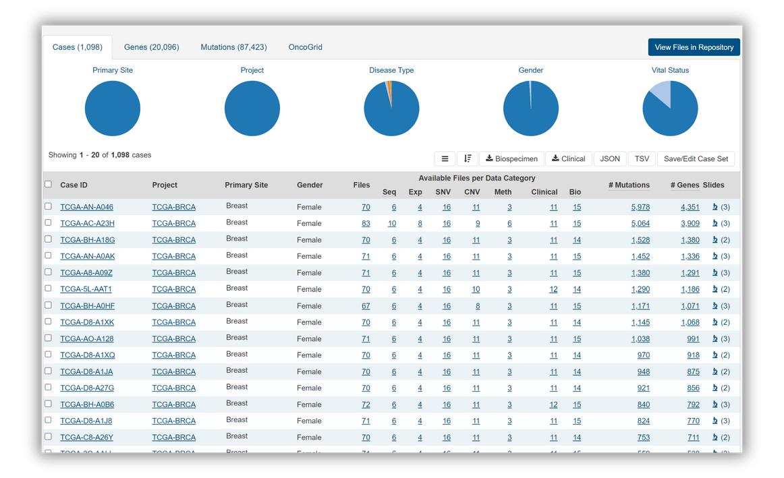
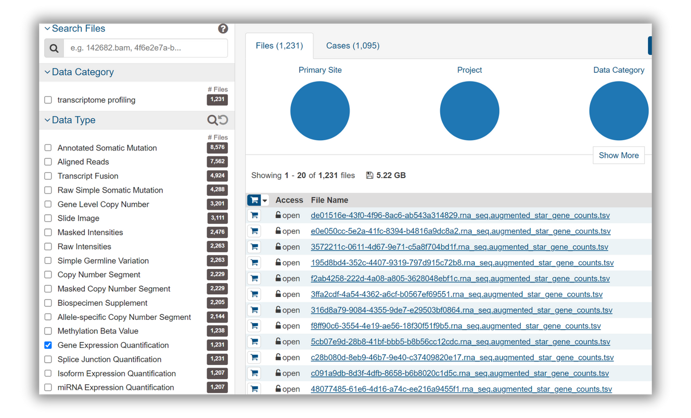
NEXT STEPS...
This is the Explore page with a list of all Case IDs.
Next go to “View Files in Repository”.
This page gives a list of all kinds of data files pertaining to the BRCA project.
Select Gene Expression Quantification in the filter and download all the tsv files.
Visit the first file to understand the nuiances.

Slide 5
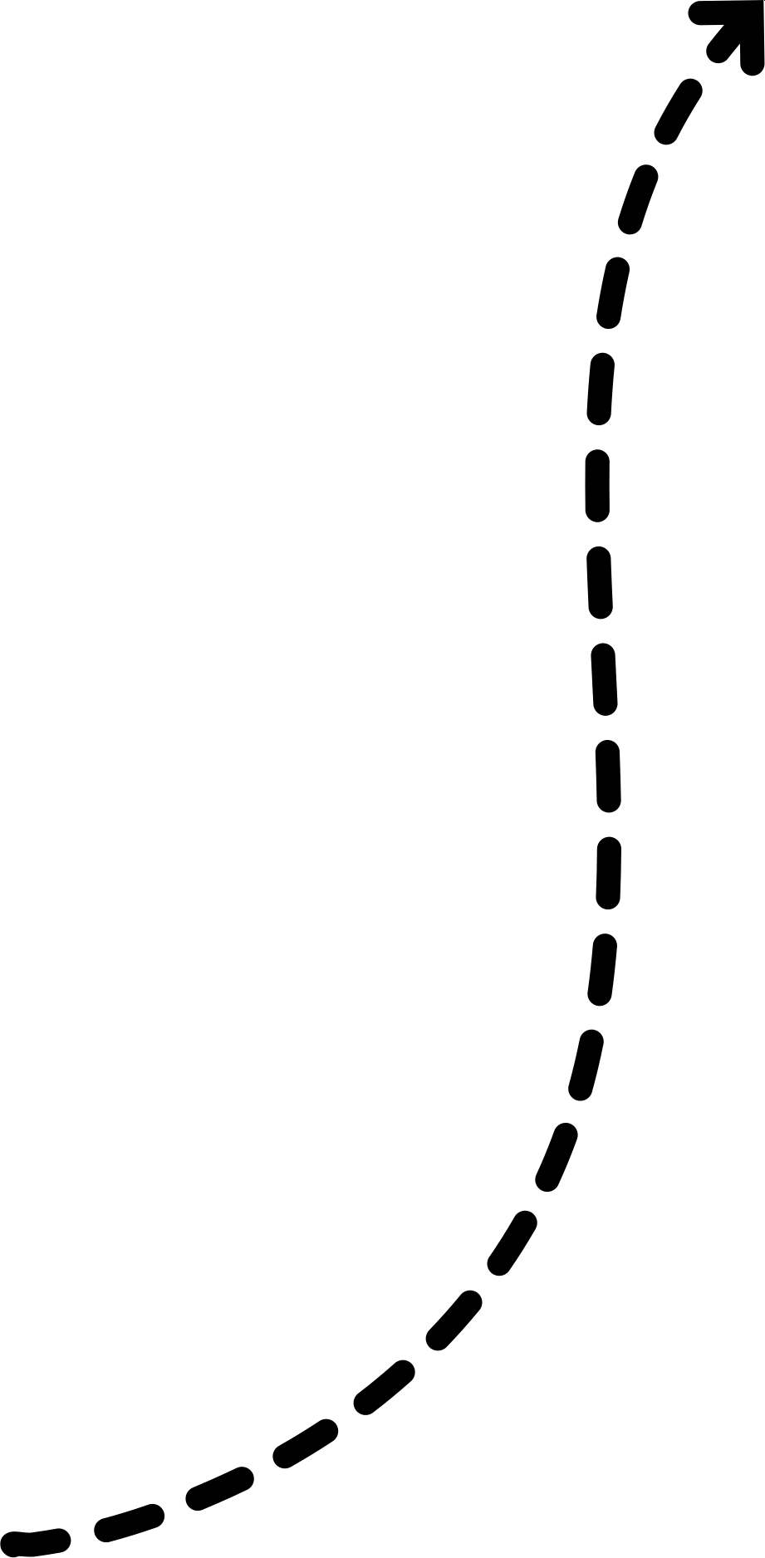
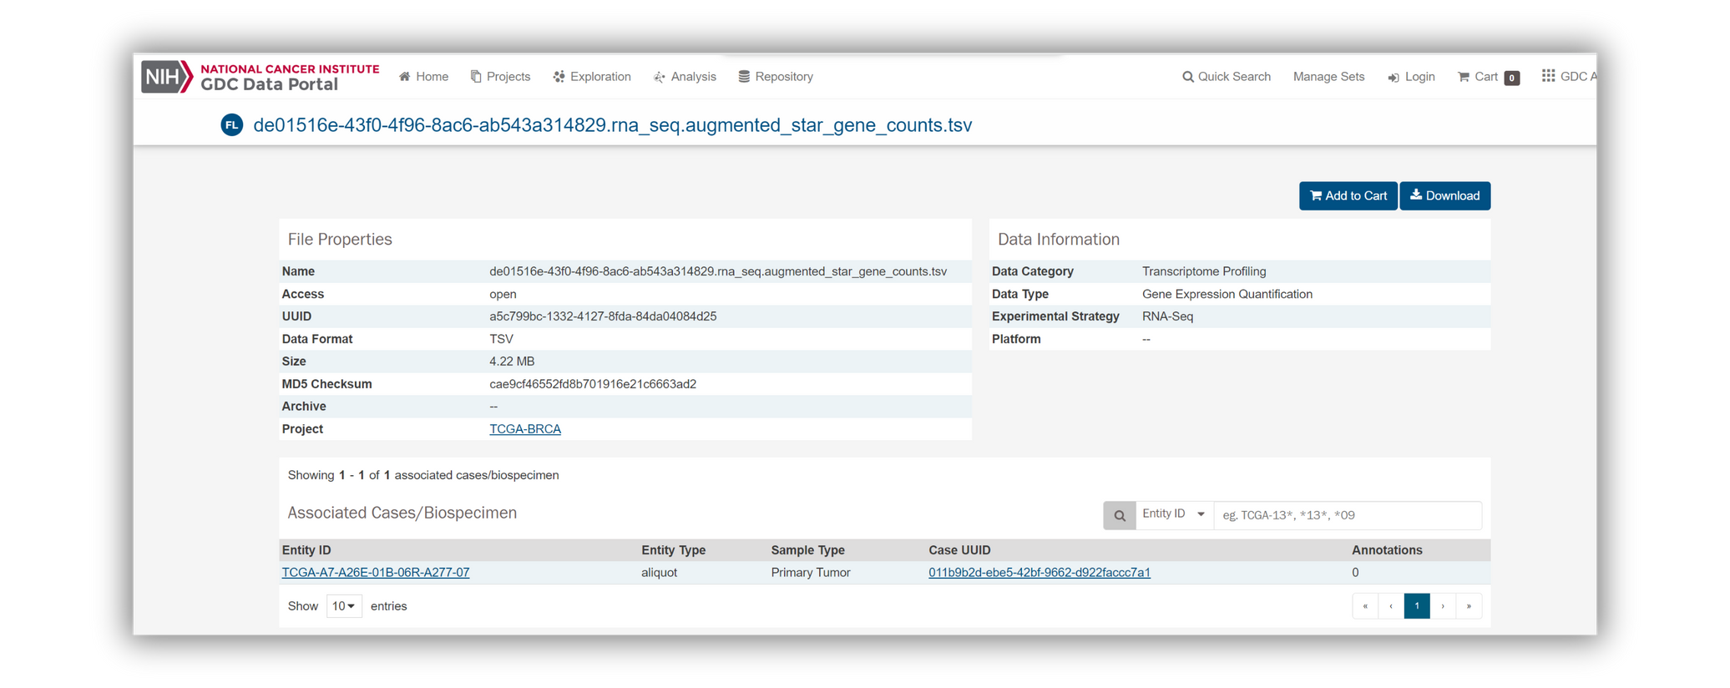
KEY IDENTIFIERS
UUID: This will be the name of the folder which will contain your file..
Data Information: This bit will be used to later in R to make queries to the GDC server.
Name: This will be the name of your respective file upon dowloading.
}
Entity ID: This will be your particular sample for the chosen case file.

Slide 6
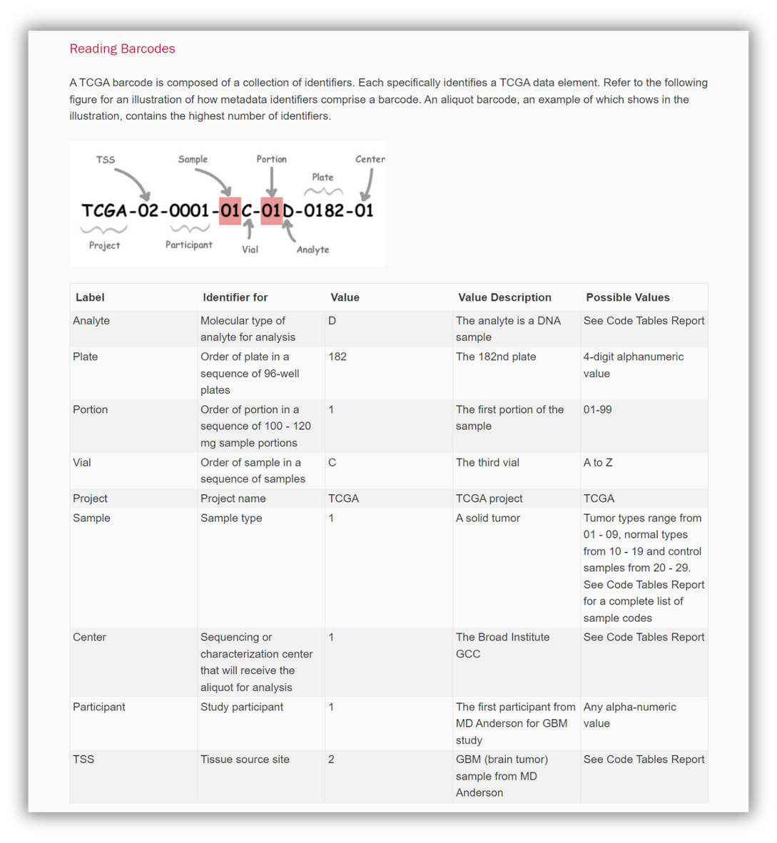
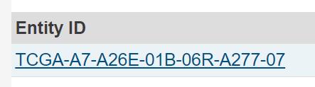
ENTITY ID
For our purposes, we only need the following four parts for our analysis:
Analyte
Plate
Portion
Vial
{
TCGA-A7-A26E-01B

Slide 7
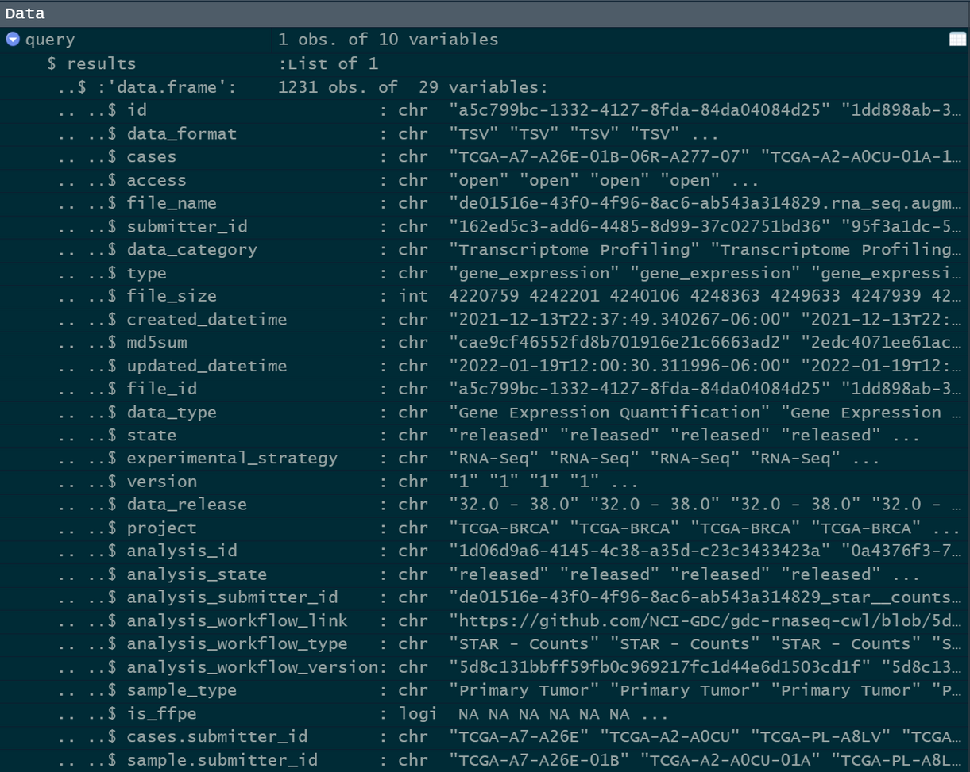
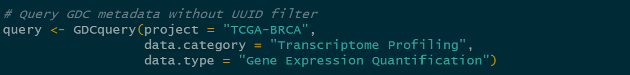
CODE
FORMING COMBINED DATAFRAME
This query fetches all the metadata from TCGA-BRCA project with the mentioned data category and type(shown previously).
This will enable us to obtain the Entity IDs for the corresponding file names which we downloaded.

Slide 8
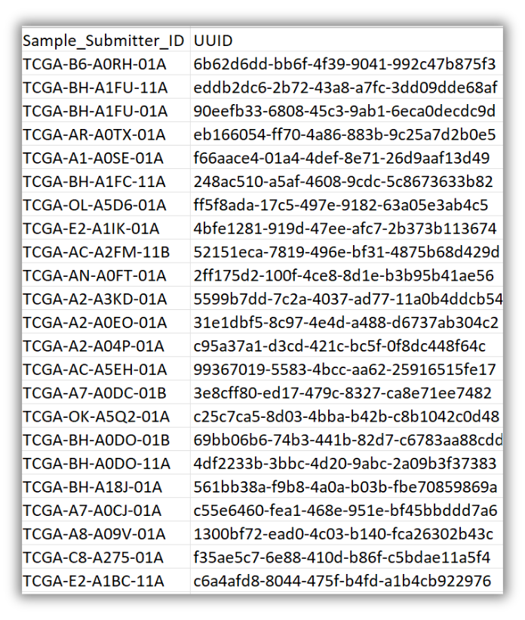
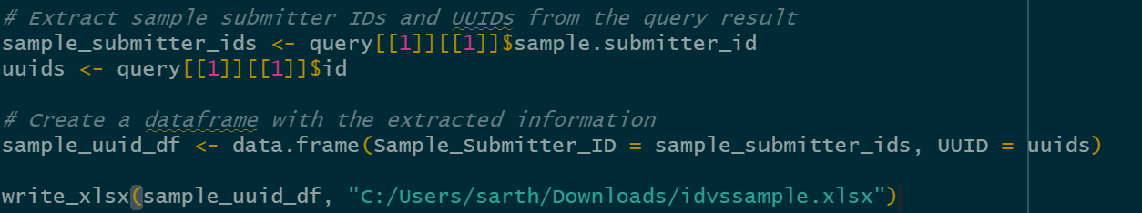
CODE
This code extracts the required two columns from our query result namely sample.submitter_id and id essentially creating an id vs. sample table.
Then it writes and saves them in a excel file for further usage.

Slide 9
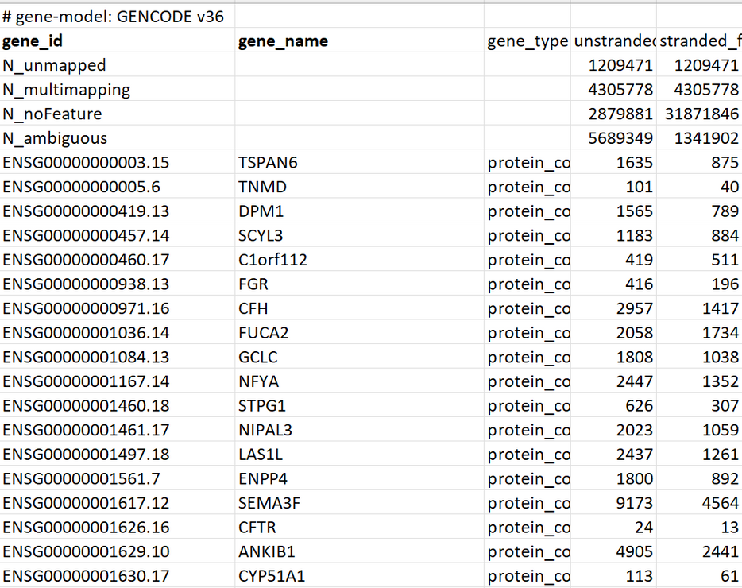
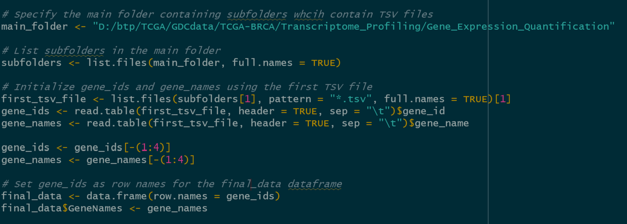
CODE
We now enter the first file(arbitrary) and extract all the gene_ids and their corresponding gene_names.
We exclude the first 4 irrelevant columns and then form the structure of our dataframe which will combine count data from all the files.

Slide 10
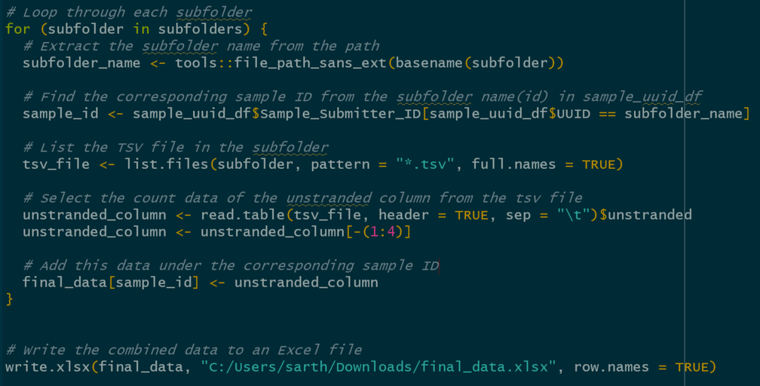

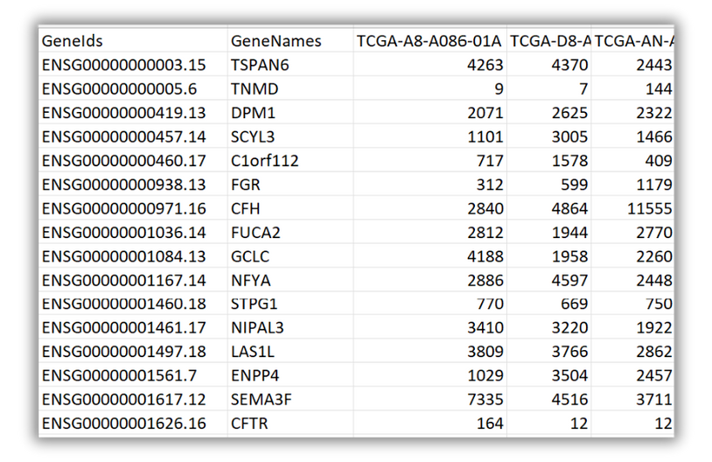
CODE
We now run a for loop; extracting the subfolder name which will give us the sample ID and opening the tsv file in each of them.
We will use the count data for unstranded column and thus extract and refine this column.
We will add this column under the respective sample ID.
Finally we will export it into an excel file.

Slide 11
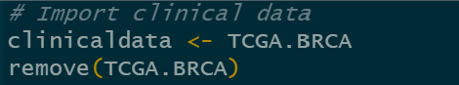
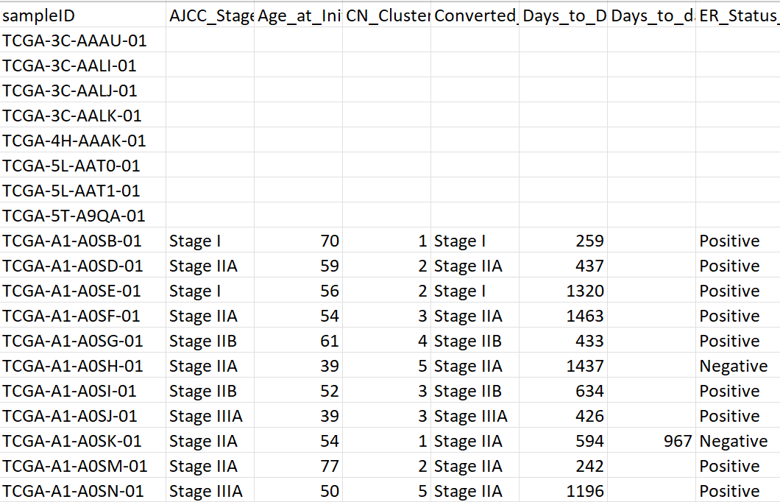
CODE
INTEGRATING ER_STATUS VALUES
Now we need to import clinical data which will have all kinds of metadata.
We will import the dataframe and assign it to the variable clinical_data.
Observe that the sampleIDs here don’t have the symbol for vial at the end.

Slide 12
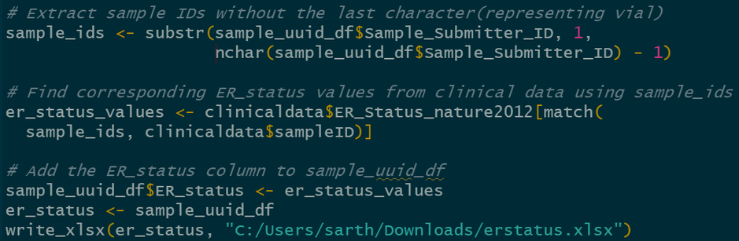
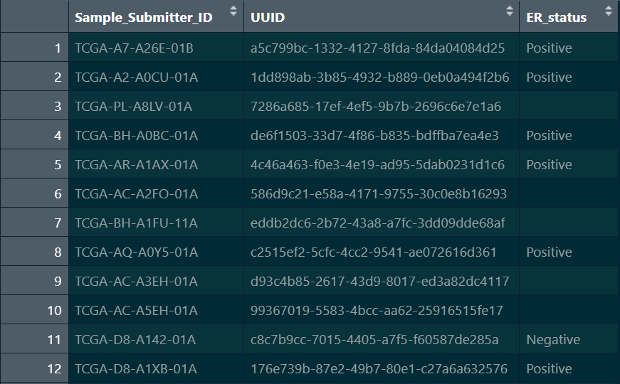
CODE
We wil obtain all the samples from our sample_uuid_df and remove the last character in each which corresponds to the vial, as the clinical data doesn’t have that.
Then we will search for the sample_ids in the clinical data and obtain their er_status.
Finally, we will add that column to the sample_uuid_df, rename it to er_status and download an excel sheet of it if required.

Slide 13
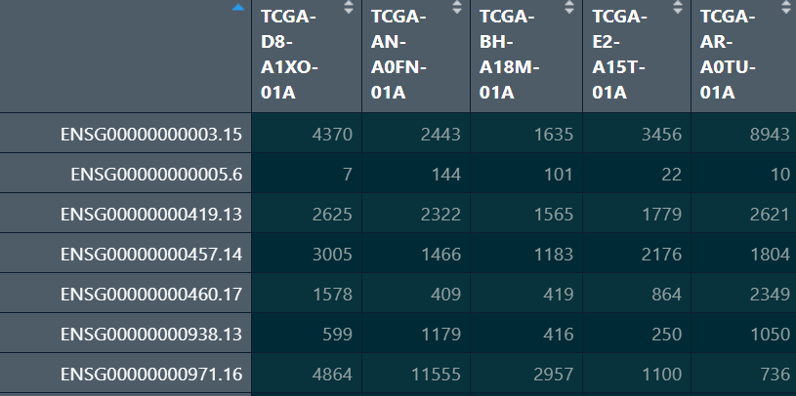
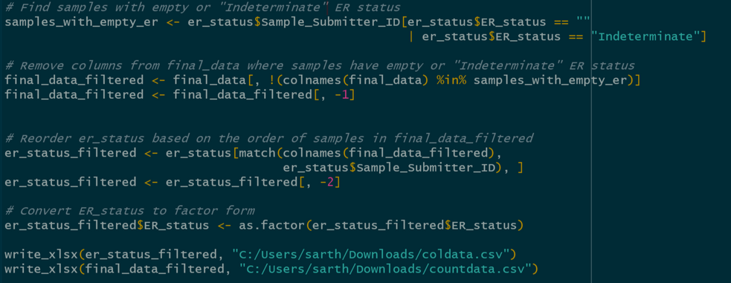
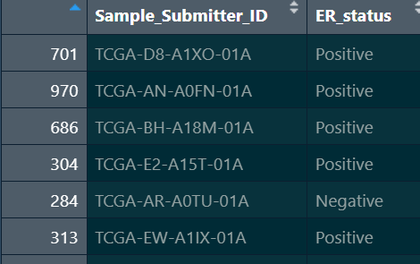
CODE
final_data_filtered
Now, we remove the samples whose Er_status is either empty or indeterminate.
We filter out the empty samples from both final_data and er_status and reorder er_status according to final_data.
We also convert the Er_status column to factor form.
er_status_filtered

Slide 14
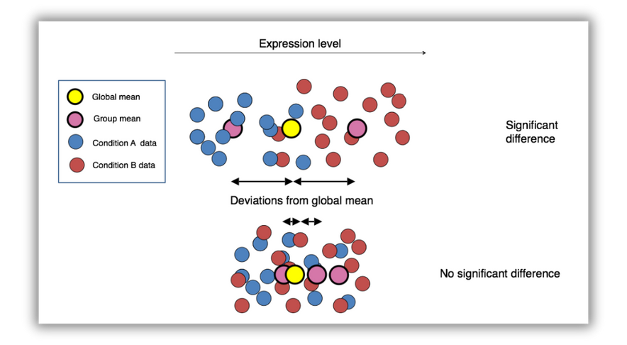
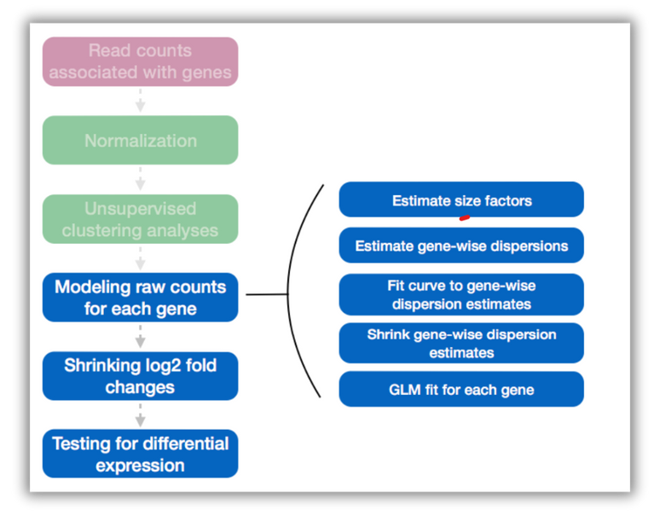
DGE
DESEQ2 (R)
Our goal is to essentially determine whether the mean expression levels of different sample groups are significantly different.
Differential expression analysis with DESeq2 involves multiple steps as displayed in the flowchart aside in blue.

Slide 15
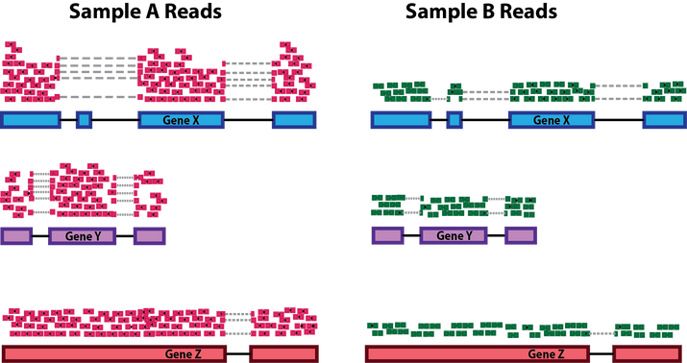
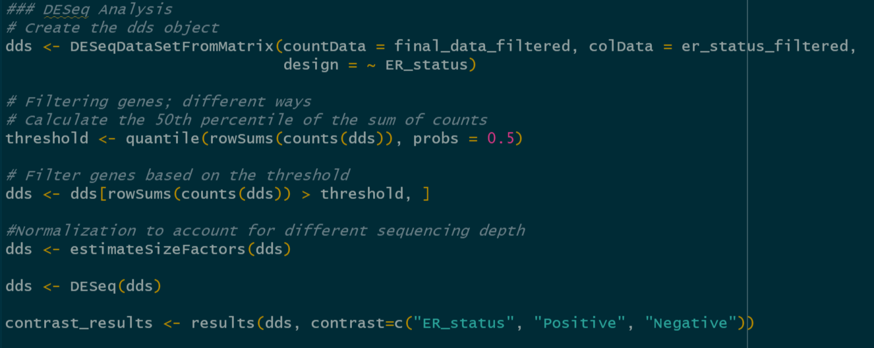
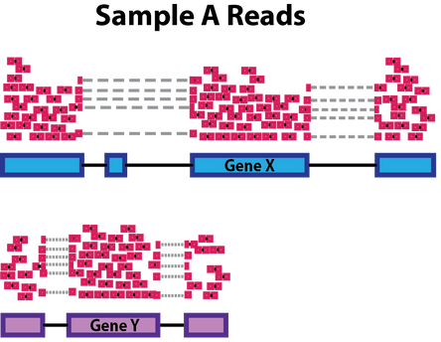
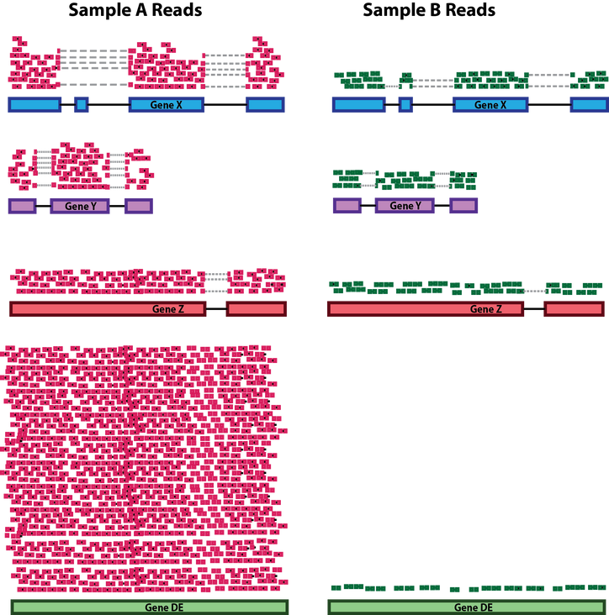
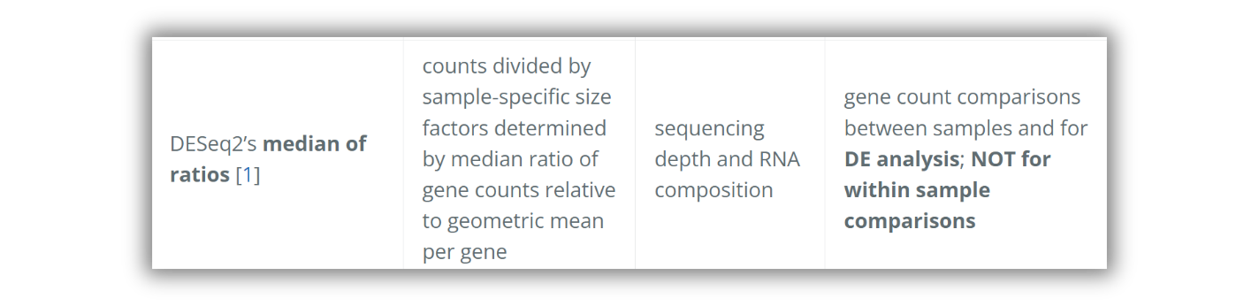
NORMALIZATION
Sequencing depth: Each gene appears to have doubled in expression in Sample A relative to Sample B, however this is a consequence of Sample A having double the sequencing depth.
Gene length: Gene X and Gene Y have similar levels of expression, but the number of reads mapped to Gene X would be many more than the number mapped to Gene Y because Gene X is longer.
RNA composition: If we were to divide each sample by the total number of counts to normalize, the counts would be greatly skewed by the DE gene, which takes up most of the counts for Sample A, but not Sample B.
To normalize the count data, DESeq2 calculates size factors for each sample using the median of ratios method

Slide 16
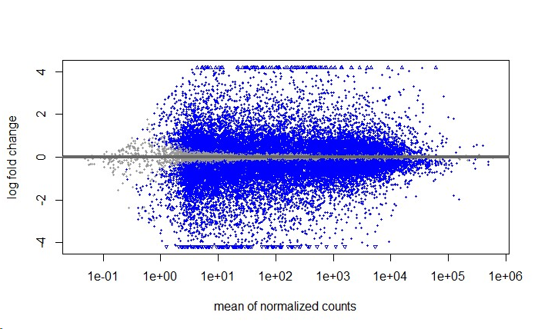
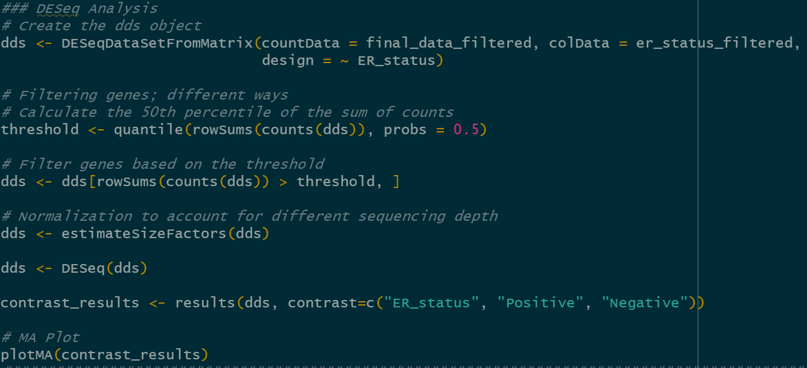
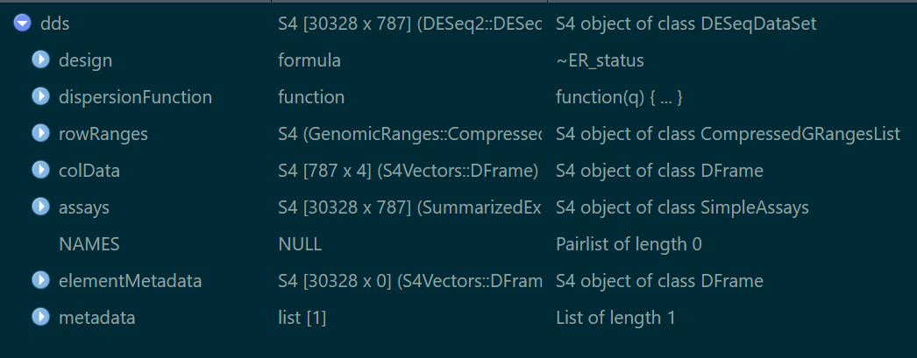
CODE
DESEQ ANALYSIS
First, create the dds object.
Then you can create thresholds to filter out necessary genes.
Finally, obtain the results contrasted against ER_status values.
We can make an MA plot to display log fold change vs Average count values.

Slide 17
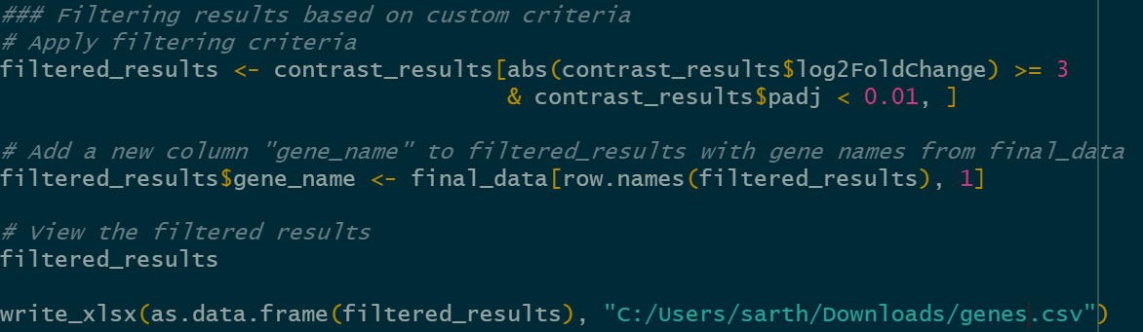
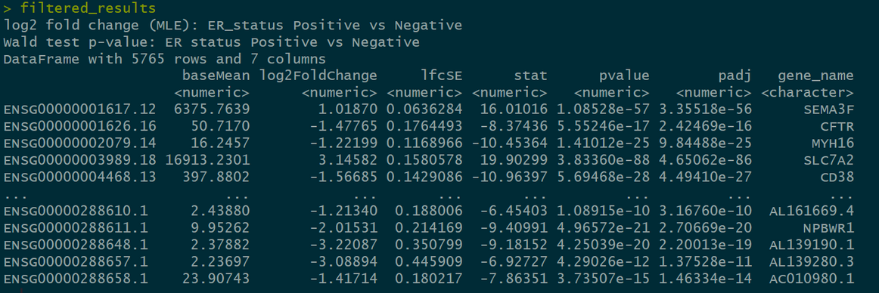
CODE
VIEWING THE RESULTS
Finally, we can choose appropriate filtering criteria to select our differentially expressed genes.
We can add the corresponding gene names to their ids.
Export the results into an excel file.

Slide 18
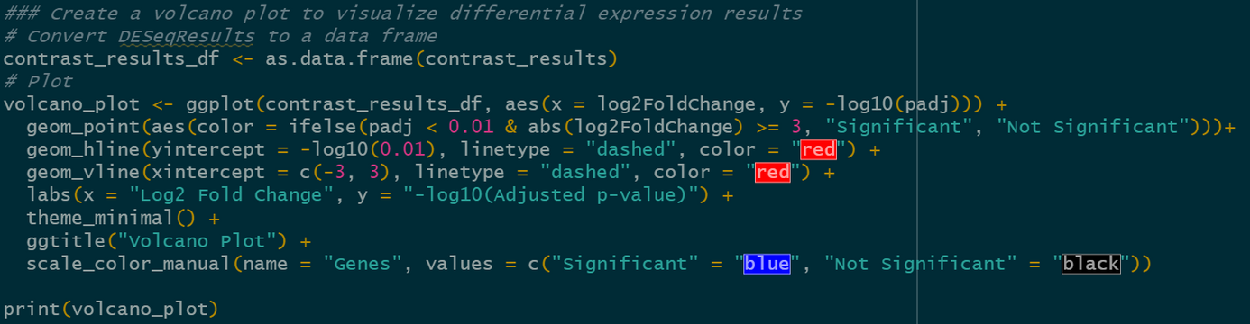
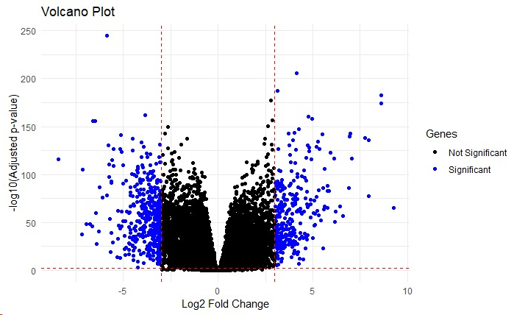
CODE
VOLCANO PLOT
We can observe our significant genes by plotting them in a volcano plot.
Here, we set the thresholds as Padj<0.01 and log2FoldCHange>3.

Slide 19
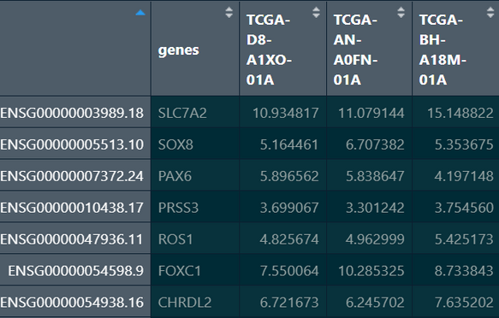
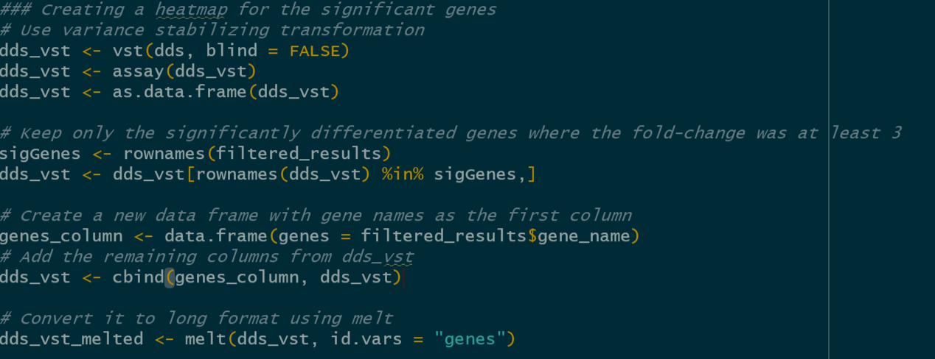
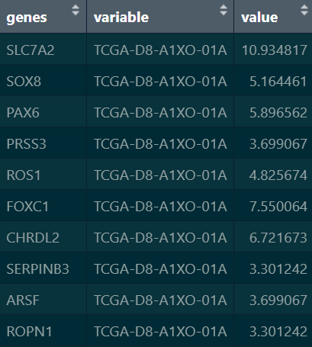
CODE
dds_vst
HEATMAP
To create a heatmap of the dds object we'll first run variance stabilising transformation(VST) on the object.
Then from the previously obtained significant genes we filter the dds_vst object. We are left with around 673 genes.
We melt the data into long format which is required for getting a heatmap.
dds_vst_melted

Slide 20
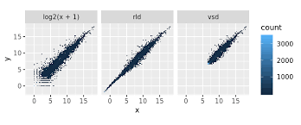
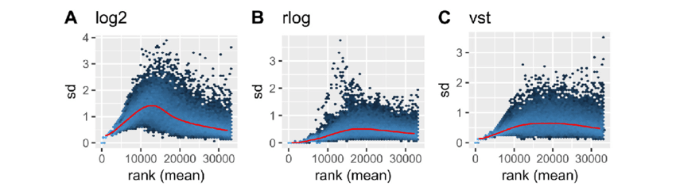
TRANSFORMATIONS ON VARIANCE
Variance Stabilising Transformations(VST): VST is used to stabilize the variance across different expression levels. It models the relationship between the mean and variance of gene expression.
rlog transformation: It aims to stabilize the variance and make the data more suitable for statistical analysis. It also has a regularized component that helps with small sample sizes.
log2 transformation: The log2 transformation is a simple logarithmic transformation that takes the base-2 logarithm of the data. It is commonly used to reduce the dynamic range of data and make it more amenable to statistical analysis.
Here are some differences between VST and rlog:
Speed: VST runs faster than rlog.
Sensitivity to outliers: VST is less sensitive to high count outliers than rlog.
Data: distribution: rlog relies more heavily on the assumption of the data distribution.
Size factor: VST takes into account both size factor and mean dispersion across the sample, while rlog only accounts for size factor.
Library size: rlog transformation is a better option than VST if the library size of the samples and therefore their size factors vary widely.
Dataset size: rlog tends to work well on small datasets (n < 30).
All of them aim to remove the dependence of the variance on the mean.
We use VST in our example because it works well with larger sample size and is also faster.

Slide 21
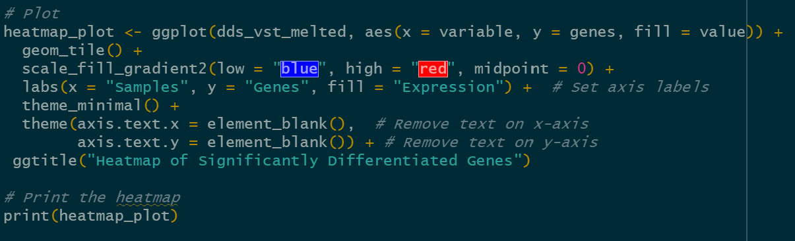
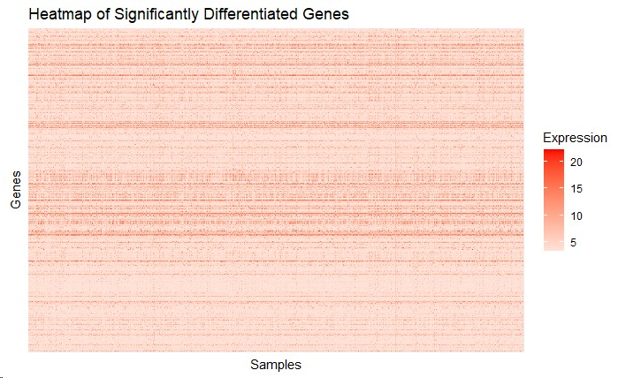
CODE
Finally, we obtain the heatmap from the transformed object.
This heatmap consists of all the significant genes only.

Slide 22

THANK YOU

